Slide 1
The Self-Concept
Today’s Lesson:
Understand factors that influence self-concept

Slide 2
Recap
Our Self-Concept
Self-Esteem
Self-Image
Our Self-Concept is made up of our self-esteem and our self-image

Slide 3
Definitions
SELF-CONCEPT
The sum total of the ways in which we think about ourselves
SELF ESTEEM
- How highly we think about our abilities and our self.
SELF IMAGE
- How we view our self based on others reactions to us.

Slide 4
A Positive Self-Concept
A positive self-concept helps us in life – how we behave and act with others.
A positive self-concept generally makes us feel happier.

Slide 5
Influences to Self-Concept
Life Experiences
Age
Sexual Orientation
Appearance
Self-Concept
Gender
Relationships
Education
Culture
Emotional Maturity

Slide 6
Age
Self-concept changes as we get older.
YOUNG CHILDREN:
OLDER CHILDREN:
ADOLESCENTS:
ADULTS:
ELDERLY:
Younger children are limited to descriptions of themselves, like boy/girl, size etc.
Older children can provide much more detailed descriptions; hair and eye colour, address, shoe size etc.
Self concept can be explained in terms of beliefs, likes and dislikes, relationships.
Adults can explain themselves in terms of quality of life and their personality.
Older adults may have developed even more self knowledge and developed ‘wisdom’.

Slide 7
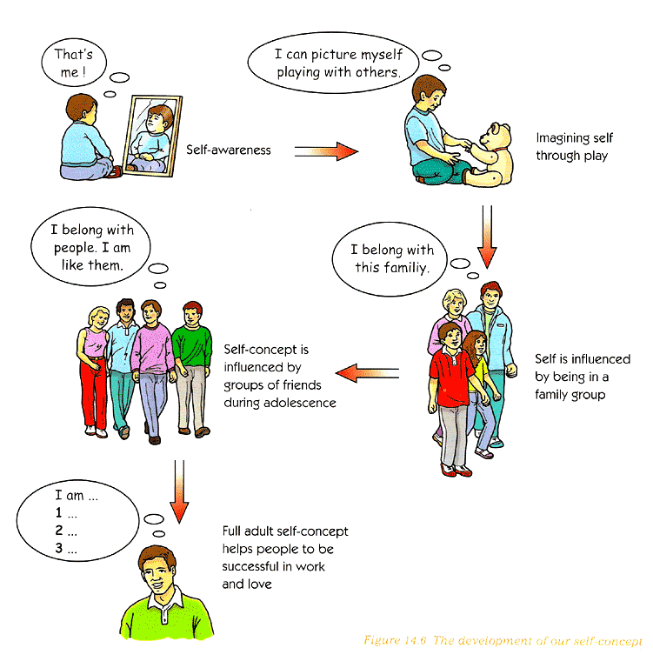

Slide 8
Appearance
By the age of 10 or 12 we begin to compare ourselves to others. If we think we look good we have a positive self-image
Last week, did anyone write anything about appearance for their celebrity? What did you write?
The important thing is we feel positive about the way we look. We can easily develop a negative self image and this can lead to a lack of confidence or to feel depressed about our relationships with other people.

Slide 9
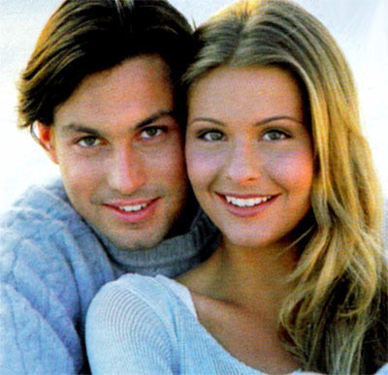
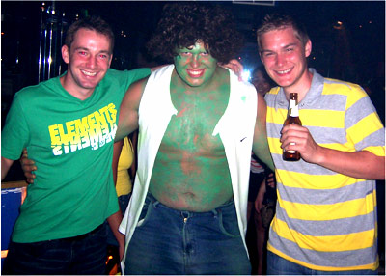
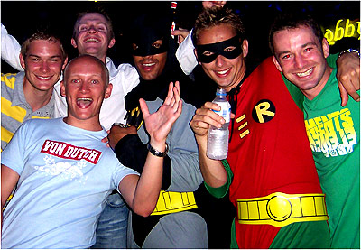
How does how we dress affect our self-concept?
How would being a model affect someone’s self-concept?

Slide 10
Gender
Very early in life we know if we are a boy or a girl. How does this affect our self-concept and our lives?
There are different social expectations of men and women
Girls tend to do much better at school than boys, but boys do better at higher education. Why is this?
Gender affects the type of employment we go for.
Women are more likely to interrupt their careers to look after children.

Slide 11
Culture
Different people have different customs and different ways of thinking. Your family or community may have different beliefs and expectations from other families and communities.
These influences affect the way we think and are called ‘cultural influences’. Different cultures have different views of what is normal or right and wrong and these are our norms.

Slide 12
Cultural Influences and Norms
Most British people wont eat frog’s legs, snails or horse meat.
Parents who do not smoke will discourage their children from smoking.
People with a strong religious belief may teach their children that sex before marriage is wrong.
People from ethnic minority groups are more likely to live in an extended family.

Slide 13
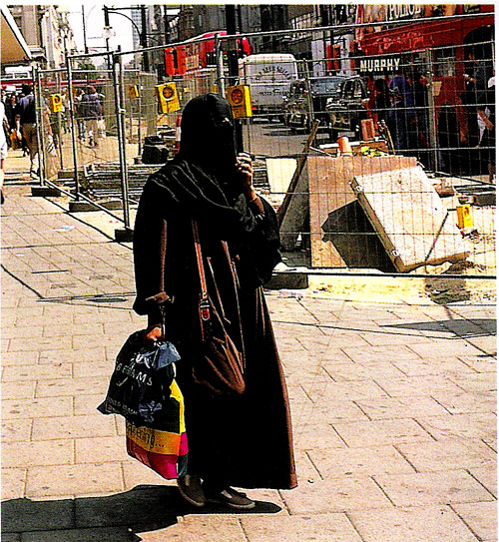
What you think of as important, or right or wrong, will be influenced by the norms of the people around you.
Your self-esteem will be influenced by cultural beliefs about what is right or wrong.
According to the culture of their country, women may have to wear certain clothing.
How do you think this affects their self-concept?

Slide 14
Today’s Lesson:
Objectives
Recap self-concept and continue on factors that can influence it.
Select one of these factors and produce a poster for the rest of the class.

Slide 15


Sexual Orientation
Sexual orientation refers to our sexual behaviour and our choice of partner. Most people are heterosexual (attracted to the opposite sex). A minority are homosexual (attracted to the same sex) and an even smaller minority are bisexual (attracted to both sexes).
Sexual orientation is certain to form part of a person’s self-concept, especially to those who are homosexual. This is because to admit to being homosexual can still be a very traumatic thing to do.

Slide 16
Problems in Society
Parents express sadness and disappointment when their child won’t form a conventional couple.
Friends may express homophobic attitudes.
May suffer prejudice at work.
May not get a job working with children.
Certain government privileges are for regular couples only.
Public opposition to adoption or fostering.

Slide 17
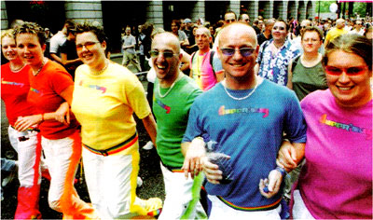
Affect on Self-Concept
Young people feel confused, even fearful as they accept they are homosexual.
It can be difficult to be positive about yourself if you receive negative signals about a big part of your life.

Slide 18
Education
Self-concept is strongly influenced by school.
You spend more than half your waking time at school, doing homework or doing school things.

Slide 19
AGREE OR DISAGREE?
You mix with other people and compare yourself to them
The expectations of teachers influence your success or failure. Students expected to do well often perform better than those not. This is a self fulfilling prophecy.
Success or failure at school has an affect on self esteem
Education influences our self-concept
Friendships boost self esteem as it shows people want to be your friend
Learn theories and ideas that help you to understand your life and that of others

Slide 20
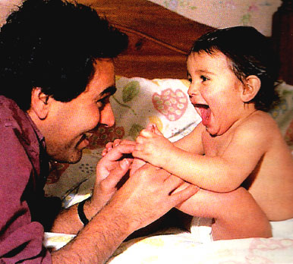
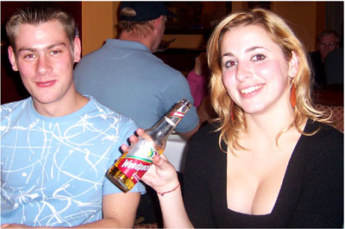
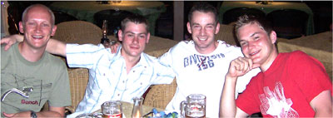
Relationships with others
Write the following list of people on the back of the handout.
Mother or step-mother
Father or step-father
Brothers and sisters
Boyfriend or girlfriend (or ex!)
Best friend
Teacher

Slide 21
Relationships’ Effects
Write one way in which each of these people have affected you or taught you something.
Which relationship affected you the most?

Slide 22
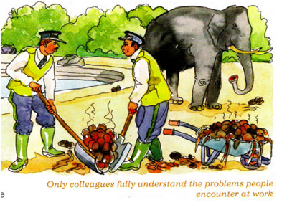
Forms of relationships
Family relationships
Work relationships
Friendly relationships
Sexual relationships
Depending on the amount of time we spend with these people and the value we place on their opinions determines the extent that they affect our self-concept.

Slide 23
Group Task
In groups of no more than 4 choose one of the factors that influence our self-concept and produce an A3 poster that contains the following information:
A title of the influencing factor (i.e. AGE)
A definition of self-concept, self-esteem and self-image
An outline of how the factor influences our self-concept.
Choose from: Age, Appearance, Gender, Culture, Education, Relationships, Sexual orientation.

Slide 24
Example
Self-Concept: xxxx
Self Esteem: xxxx
Self Image: xxxx
Childhood
Older Children
AGE
Elderly
Adults
Adolescence

Slide 25
Extension Questions
When you have completed your poster and are fully prepared to present it to the class answer the following questions:
1. How might a very young child describe their self-concept?
2. How can the way we dress affect our self-concept?
3. Write about a time when your own self image was affected. Why did this happen?

